Slide 1



Comparing modeling approaches
for predicting
live aboveground carbon
in
southern Appalachia
Tara Skiba¹, Tyler Gifford¹, Sheng-I Yang², and Tom Brandeis³
¹ School of Natural Resources, University of Tennessee, 2431 Joe Johnson Dr, Suite 401, Knoxville, TN 37996, USA
² Warnell School of Forestry and Natural Resources, University of Georgia, 180 E Green Street, Athens, GA 30602, USA
³ USDA Forest Service, Southern Research Station, 2730 Cherokee Farm Way, Suite 101, Knoxville, TN 37920, USA

Slide 2
Needs and justification
1
Species-specific biomass equations used with ground-based, tree-level forest inventories provide the most accurate estimates of carbon
But conducting these inventories are time and resource intensive.
Collecting tree-level field data and fitting species-specific biomass equations (carbon c≈biomass/2)²
Successful forest monitoring requires efficient estimation, especially to track landscape-level changes from disturbances from fire, invasives, and logging
Therefore, there is a need to develop alternative models that provide fast stand-level carbon estimates.
Using stand-level and environmental predictors means less intense inventories and avoiding species-specific biomass equations to decrease processing time.
¹ Yang SI, Brandeis TJ, Skiba T. Quantifying Stand-level Carbon Using an Alternative Method: A Case Study of National Forests and Parks in Southern Appalachian Mountains. J For 2025;123(5):653–74. https://doi.org/10.1007/s44392-025-00044-x.
² Hudak AT, Bakken JL, Lister A et al. A quantitative evaluation of forest aboveground biomass density map products in Oregon, USA. Environ Res Lett 2026;21(14):143007. https://doi.org/10.1088/1748-9326/ae8b04.

Slide 3
Methods and study area
2
Three modeling approaches:
Linear mixed-effects models (LME)¹
Mixed LASSO (Least absolute shrinkage and selection operator)
  Feature selection
  Adjustable λ parameter
GAMM (Generalized additive mixed models)
  Non-linear model using smooth functions
Random effect added on forest type
Two variable groups:
Stand-level variables
  D, H, H:D, QMD, BAPH, TPH, Stand Density Index (SDI), Slope, and Aspect
Bioclimate variables
  19 temperature and precipitation variables from WorldClim BIO¹
  V1 dataset availability 1/1/1960 – 1/1/1991
¹ https://developers.google.com/earth-engine/datasets/catalog/WORLDCLIM_V1_BIO

Slide 4
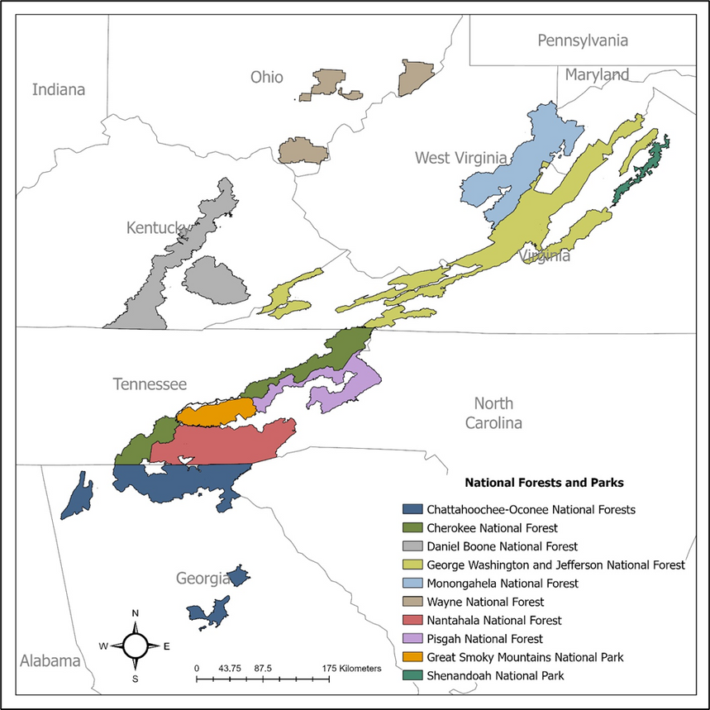
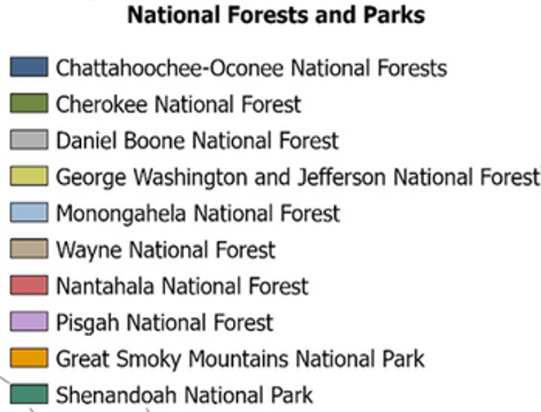
Methods and study area
3
FIA permanent plots located within national forests and parks of southern Appalachian were used:
Region | Obs | FT
Chattahoochee-Oconee | 1681 | 32
Cherokee | 1335 | 33
Nantahala | 515 | 27
Pisgah | 469 | 24
George Washington-Jefferson | 2491 | 33
Daniel Boone | 576 | 26
Monongahela | 1244 | 30
Wayne | 384 | 24
Great Smoky Mountains | 392 | 32
Shenandoah | 169 | 14
Total | 9256
Forests
Parks

Slide 5
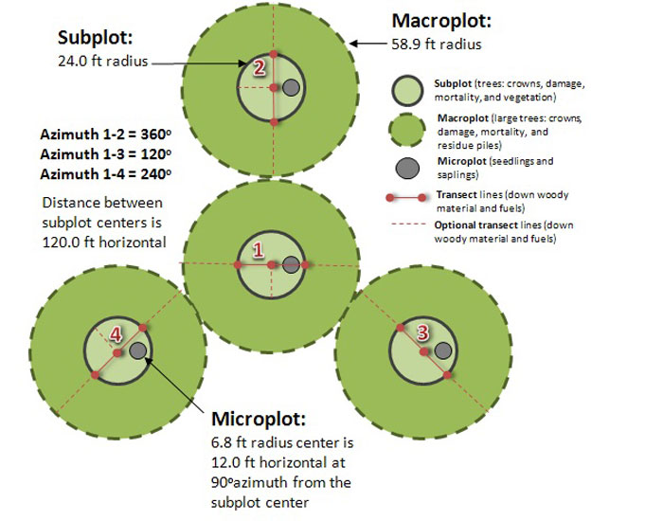
Methods and study area
4
Condition-level treated as plot
Models trained with 1000 bootstrap samples
70/30 in-bag/out-of-bag split
LASSO’s λ optimization:
5-fold cross validation
Searching over 0-500, increments of 5.
 | Stand-only | Stand+bio
LME
LASSO
GAMM
Condition 1
Condition 3
Condition 2
FIA plot design¹
¹ https://csfs.colostate.edu/science/forest-inventory-analysis/rural-fia/

Slide 6
Results – Modeling approaches (stand-only)
5
Best performing: LME
High overall accuracy and low bias (OOB: ~95%% R², ~-0.1 MB, ~10 RMSE)
Easy to fit, with little data cleaning needed
Second place: GAMMs
Performs approximately the same as LME with stand-level variables
Some perform better, some worse (differences of ±1% OOB R², ±0.2 OOB MB, ±1 OOB RMSE to LME)
Last place: LASSO
Worst predictive power of all (differences of -1 to -7% OOB R², x2+ OOB MB, +1 to +7 OOB RMSE to LME)
Lower 2.5% of OOB samples’ R² noticeably lower (Shenandoah lower OOB CI R²: 0.46)

Slide 7
Results – Inclusion of bioclimate variables
6
Winning model: LMEs
improved compared to stand-only
(higher R², lower MB and RMSE)
Second-tier models: GAMMs and LASSO
Performance metrics (R², MB, RMSE): similar to or worse than stand-only LASSO and GAMMs
Confidence intervals grow – shows high variability within OOB samples
Shenandoah National Park
  OOB R² confidence intervals:
    GAMM : 0.09, 0.94
    LASSO: 0.06, 0.91
  MB and RMSE noticeably increases

Slide 8
Discussion
7
Sample size affects LASSO and GAMM performance
Name | Obs.
Shenandoah | 169
Wayne | 384
Great Smoky Mountains | 392
Pisgah | 469
Nantahala | 515
Daniel Boone | 576
Monongahela | 1244
Cherokee | 1335
Chattahoochee-Oconee | 1681
George Washington-Jefferson | 2491

Slide 9
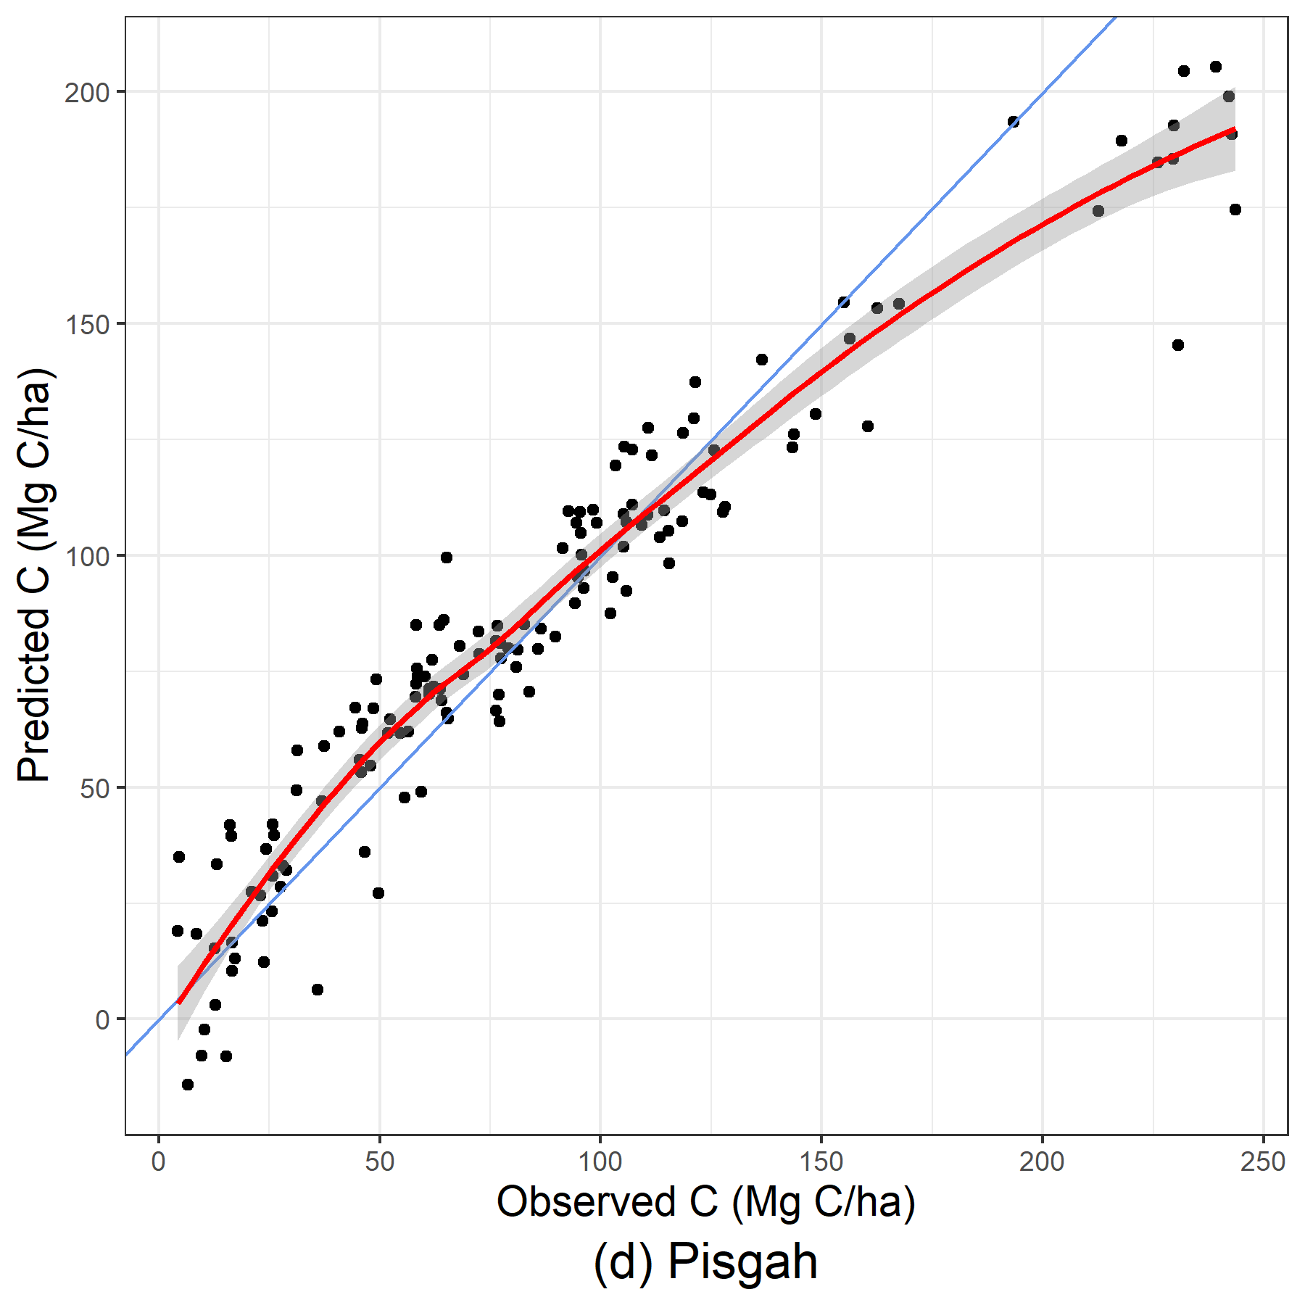
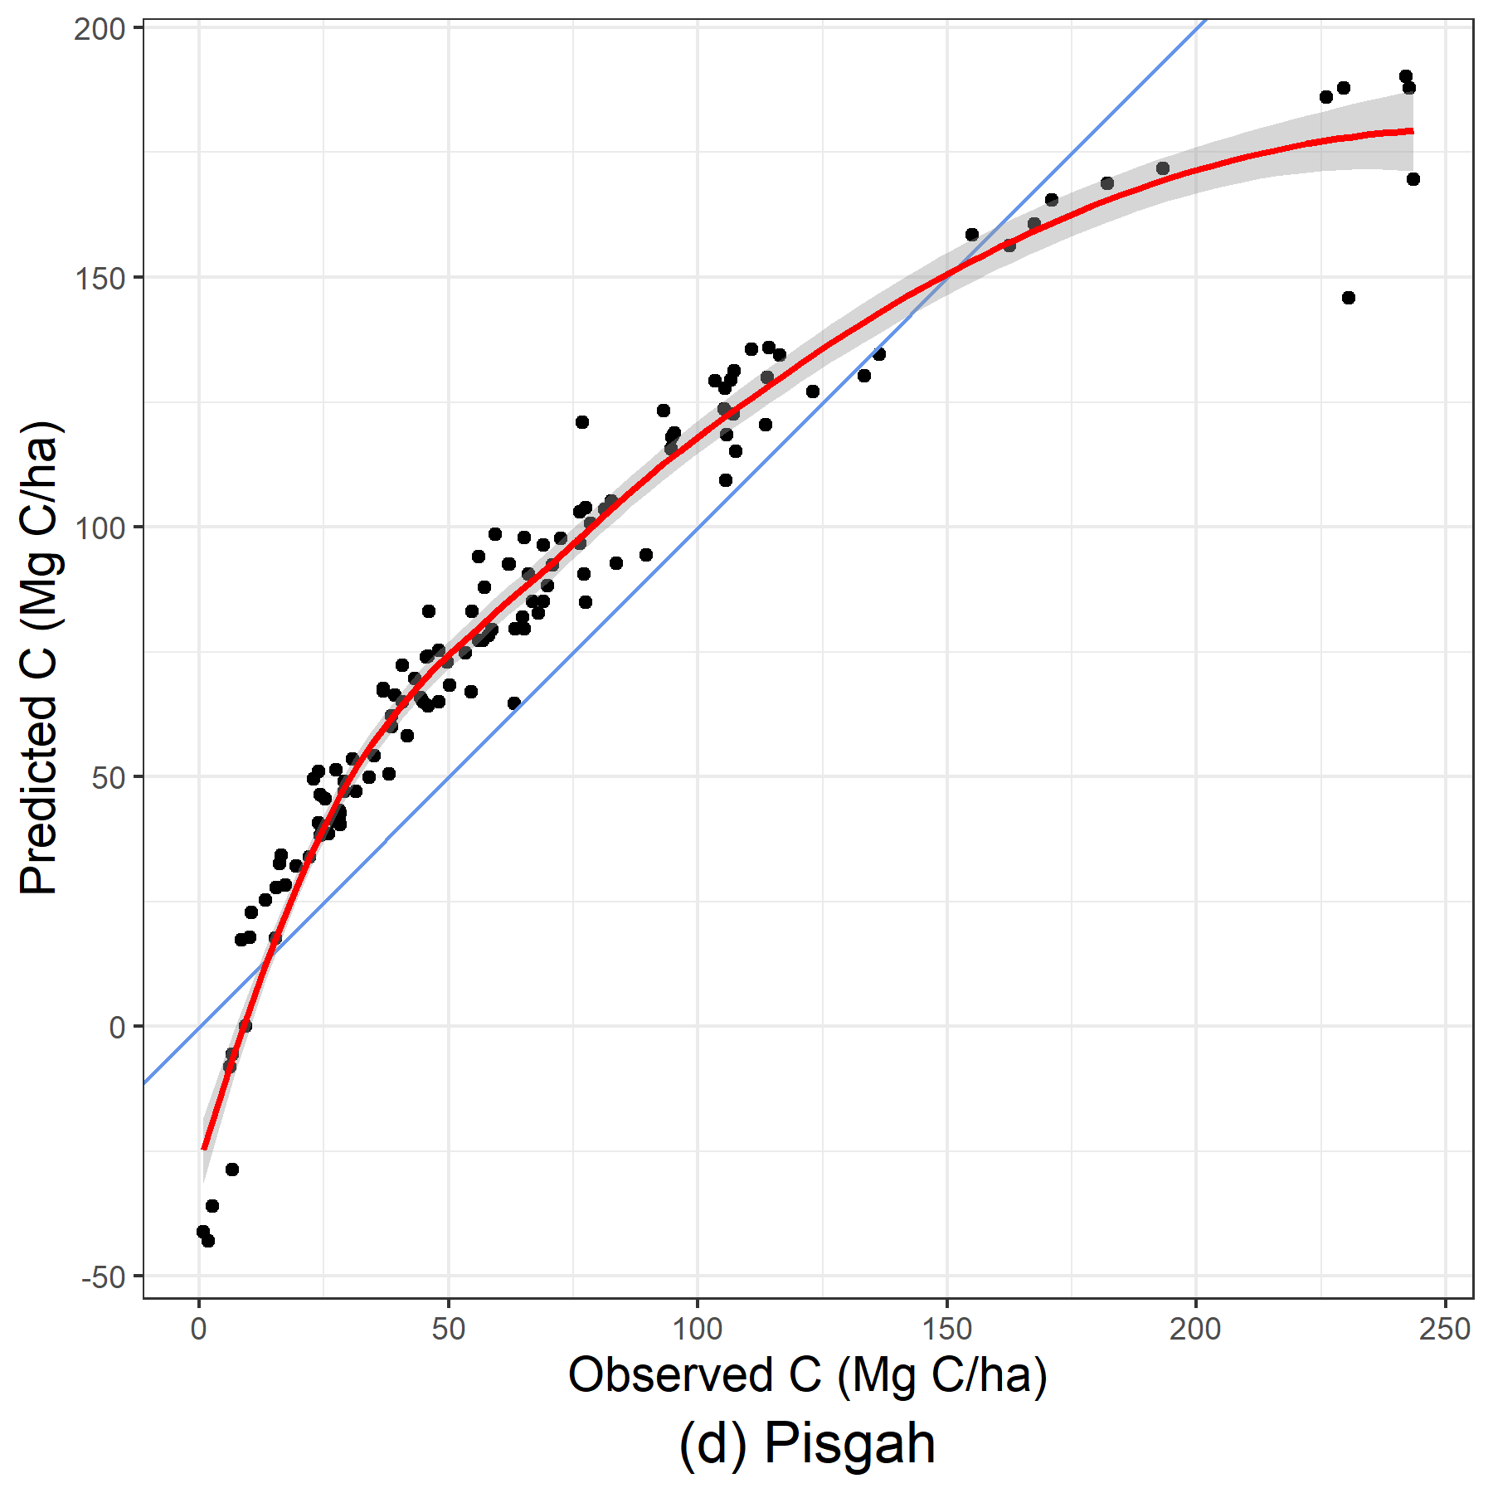
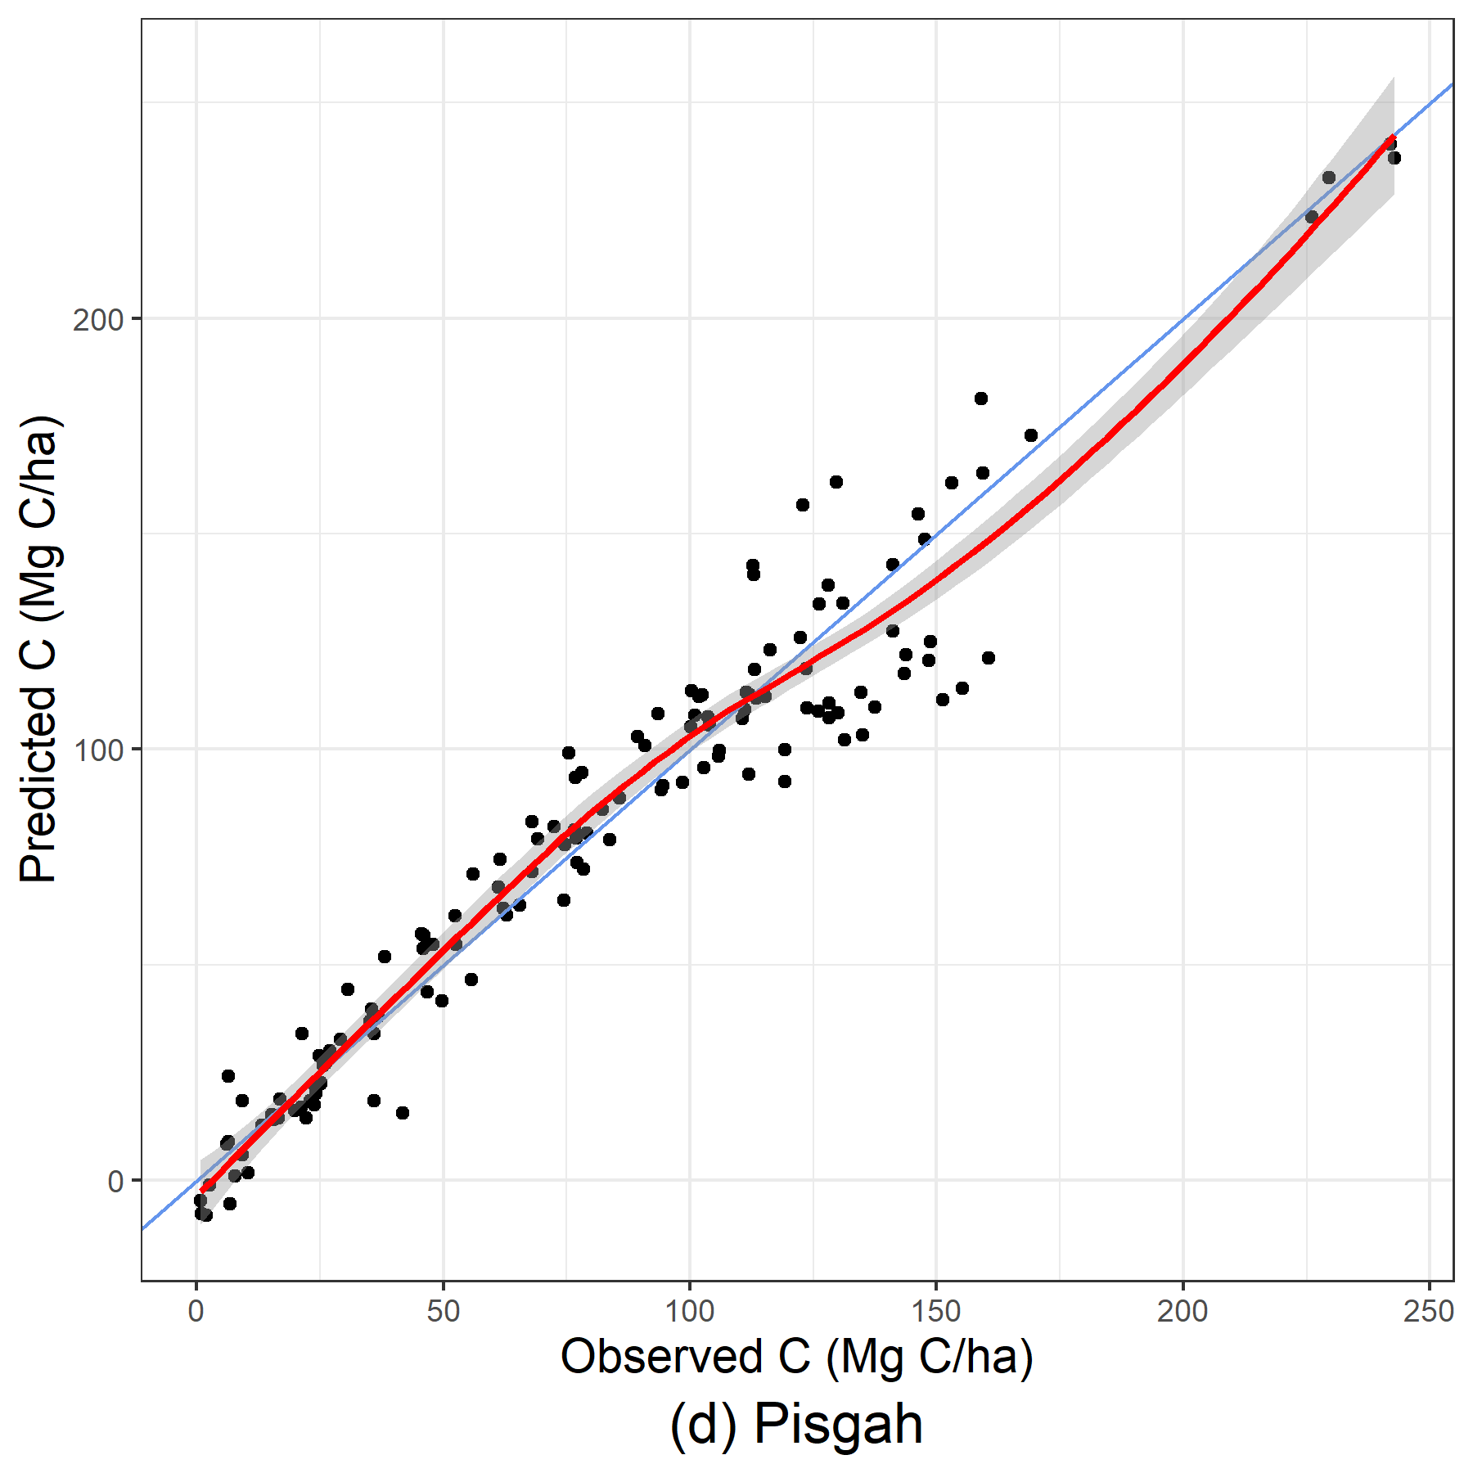
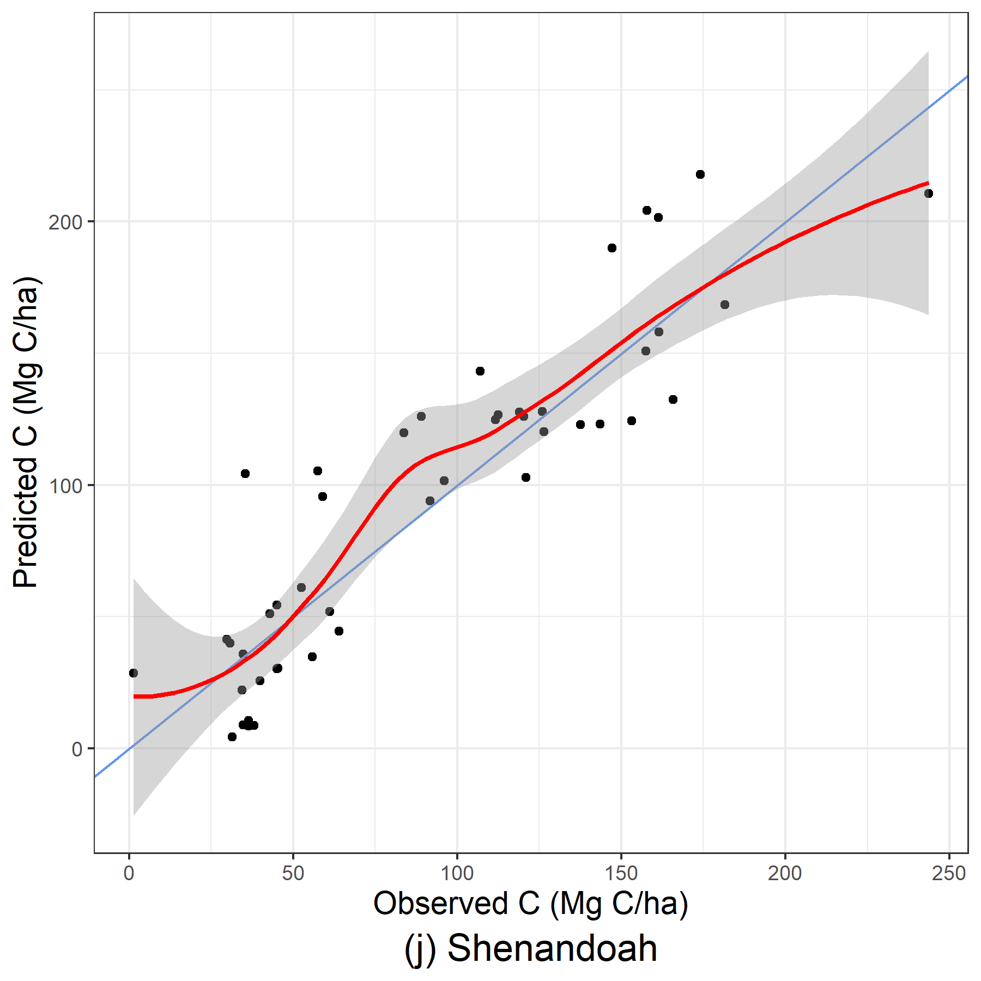
Discussion
8
Single OOB sample predicted vs observed values
LME is good, struggles at larger C values
LASSO stand-only is poor, stand+env is unusable
GAMMs have variable performance but could better capture larger C values
Pisgah stand+bio LME
Pisgah stand+bio LASSO
Pisgah stand+bio GAMM
Shen stand+bio GAMM

Slide 10
Discussion
9
Do bioclimate variables improve models?
It depends ☺
First, bio07 (Temperature annual range (bio05-bio06)) was dropped or removed from all models
LMEs: improves ~1% OOB R²
LASSO and GAMMs: increased instability in some regions
Multicollinearity present between WorldClim BIO variables¹
  Problematic for fitting GAMMs to Shenandoah
  Manually removed bio11 and 19 (mean temperature of coldest quarter and precipitation of coldest quarter, respectively)
  Is this extra data cleaning worth it to you?
¹ Pradhan P, Setyawan A. Filtering multi-collinear predictor variables from multi-resolution rasters of WorldClim 2.1 for Ecological Niche Modeling in Indonesian context. Asian Journal of Forestry 2021;5:111–22. https://doi.org/10.13057/asianjfor/r050207.

Slide 11
Discussion
10
LASSO λ optimization
λ was optimized using a 5-fold cross validation, iteratively from 0 to 500 at increments of 5
Median λ values
 | Stand-only | Stand+Bioclim
Chattahoochee-Oconee | 0.00 | 0.00
Cherokee | 0.00 | 0.00
Nantahala | 0.00 | 0.00
Pisgah | 5.00 | 0.00
George Washington-Jefferson | 0.00 | 0.00
Daniel Boone | 5.00 | 0.00
Monongahela | 5.00 | 0.00
Wayne | 25.00 | 5.00
Great Smoky Mountains | 5.00 | 0.00
Shenandoah | 10.00 | 500.00
Massive penalties due to what?

Slide 12
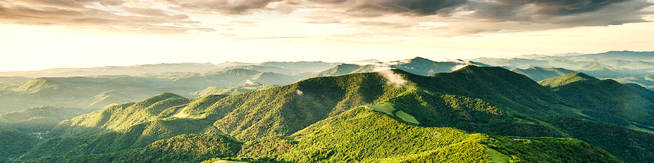
Thank you
Final Takeaways
11
LME produces the best estimates and are fast (include bioclimate variables if you desire)
GAMMs can be helpful when predicting higher values of carbon (>150 MgC/ha) and are still fast
But check model performance before implementing!
LASSO regression with λ optimization is time intensive and has reduced predictive power to varying degrees
tskiba@vols.utk.edu
Funding was provided by USDA Forest Service Agreement # 21-CR-11330145-070.

Slide 13
Results - Modeling approaches
i
STAND-ONLY LME | R-squared |  |  |  |  |  | MB |  |  |  |  |  | RMSE
 | IB | CI |  | OOB | CI |  | IB | CI |  | OOB | CI |  | IB | CI |  | OOB | CI
Chattahoochee-Oconee | 0.96 | 0.95 | 0.96 | 0.95 | 0.94 | 0.96 | 0.00 | 0.00 | 0.00 | -0.03 | -1.56 | 1.72 | 9.01 | 8.54 | 9.46 | 9.71 | 8.66 | 10.79
Cherokee | 0.96 | 0.95 | 0.96 | 0.95 | 0.94 | 0.96 | 0.00 | 0.00 | 0.00 | -0.07 | -2.20 | 2.13 | 9.41 | 8.79 | 9.94 | 10.46 | 9.06 | 11.83
Nantahala | 0.95 | 0.93 | 0.97 | 0.93 | 0.88 | 0.96 | 0.00 | 0.00 | 0.00 | -0.06 | -4.10 | 4.40 | 10.21 | 7.26 | 11.48 | 11.95 | 8.32 | 16.29
Pisgah | 0.96 | 0.95 | 0.97 | 0.94 | 0.90 | 0.97 | 0.00 | 0.00 | 0.00 | -0.36 | -4.58 | 3.90 | 10.83 | 8.60 | 11.94 | 13.18 | 9.83 | 17.24
George Washington-Jefferson | 0.96 | 0.95 | 0.96 | 0.95 | 0.94 | 0.96 | 0.00 | 0.00 | 0.00 | 0.03 | -1.27 | 1.39 | 8.26 | 7.80 | 8.64 | 8.83 | 7.87 | 9.80
Daniel Boone | 0.95 | 0.95 | 0.96 | 0.93 | 0.90 | 0.95 | 0.00 | 0.00 | 0.00 | 0.05 | -3.50 | 3.56 | 9.49 | 8.43 | 10.39 | 11.39 | 9.12 | 14.09
Monongahela | 0.94 | 0.93 | 0.95 | 0.93 | 0.91 | 0.95 | 0.00 | 0.00 | 0.00 | -0.01 | -2.34 | 2.24 | 11.73 | 11.09 | 12.25 | 12.71 | 11.26 | 14.22
Wayne | 0.93 | 0.91 | 0.95 | 0.90 | 0.85 | 0.93 | 0.00 | 0.00 | 0.00 | -0.05 | -4.12 | 4.54 | 10.45 | 9.13 | 11.46 | 12.74 | 10.19 | 15.44
Great Smoky Mountains | 0.95 | 0.94 | 0.96 | 0.93 | 0.89 | 0.95 | 0.00 | 0.00 | 0.00 | -0.15 | -4.52 | 4.29 | 10.07 | 8.67 | 11.16 | 12.53 | 10.09 | 15.34
Shenandoah | 0.98 | 0.97 | 0.99 | 0.94 | 0.88 | 0.97 | 0.00 | 0.00 | 0.00 | -0.25 | -5.10 | 4.37 | 4.84 | 3.45 | 6.48 | 9.94 | 5.95 | 13.82

Slide 14
Results - Modeling approaches
ii
STAND-ONLY GAMM | R-squared |  |  |  |  |  | MB |  |  |  |  |  | RMSE
 | IB | CI |  | OOB | CI |  | IB | CI |  | OOB | CI |  | IB | CI |  | OOB | CI
Chattahoochee-Oconee | 0.96 | 0.96 | 0.97 | 0.95 | 0.94 | 0.96 | 0.00 | 0.00 | 0.00 | -0.13 | -1.81 | 1.60 | 8.68 | 8.18 | 9.13 | 9.73 | 8.45 | 11.08
Cherokee | 0.96 | 0.95 | 0.96 | 0.95 | 0.93 | 0.96 | 0.00 | 0.00 | 0.00 | -0.02 | -2.09 | 2.02 | 9.60 | 8.97 | 10.07 | 10.60 | 9.30 | 12.04
Nantahala | 0.95 | 0.94 | 0.97 | 0.93 | 0.88 | 0.96 | 0.00 | 0.00 | 0.00 | -0.12 | -3.92 | 4.37 | 9.92 | 6.98 | 11.10 | 11.34 | 8.33 | 16.13
Pisgah | 0.97 | 0.96 | 0.98 | 0.95 | 0.90 | 0.97 | 0.00 | 0.00 | 0.00 | -0.39 | -4.29 | 4.13 | 10.09 | 8.10 | 11.26 | 12.85 | 9.63 | 17.36
George Washington-Jefferson | 0.96 | 0.96 | 0.96 | 0.95 | 0.94 | 0.96 | 0.00 | 0.00 | 0.00 | -0.02 | -1.29 | 1.24 | 8.07 | 7.65 | 8.42 | 8.75 | 7.90 | 9.73
Daniel Boone | 0.95 | 0.94 | 0.96 | 0.92 | 0.87 | 0.95 | 0.00 | 0.00 | 0.00 | -0.20 | -3.94 | 3.84 | 9.87 | 8.61 | 10.86 | 12.40 | 9.58 | 15.75
Monongahela | 0.95 | 0.94 | 0.95 | 0.93 | 0.91 | 0.95 | 0.00 | 0.00 | 0.00 | -0.06 | -2.35 | 2.11 | 11.05 | 10.44 | 11.60 | 12.37 | 10.83 | 14.23
Wayne | 0.93 | 0.91 | 0.95 | 0.89 | 0.82 | 0.93 | 0.00 | 0.00 | 0.00 | 0.05 | -4.30 | 4.79 | 10.51 | 9.12 | 11.69 | 13.56 | 10.45 | 16.55
Great Smoky Mountains | 0.95 | 0.94 | 0.96 | 0.92 | 0.88 | 0.95 | 0.00 | 0.00 | 0.00 | 0.01 | -4.82 | 4.38 | 10.31 | 8.75 | 11.42 | 12.98 | 10.49 | 16.12
Shenandoah | 0.98 | 0.98 | 0.99 | 0.93 | 0.85 | 0.97 | 0.00 | 0.00 | 0.00 | 0.16 | -5.99 | 5.28 | 4.80 | 3.51 | 6.21 | 10.71 | 6.62 | 14.85

Slide 15
Results - Modeling approaches
iii
STAND-ONLY LASSO | R-squared |  |  |  |  |  | MB |  |  |  |  |  | RMSE
 | IB | CI |  | OOB | CI |  | IB | CI |  | OOB | CI |  | IB | CI |  | OOB | CI
Chattahoochee-Oconee | 0.96 | 0.96 | 0.97 | 0.95 | 0.90 | 0.96 | 0.00 | 0.00 | 0.00 | -0.18 | -8.62 | 7.82 | 8.69 | 8.20 | 9.13 | 10.22 | 8.62 | 13.95
Cherokee | 0.96 | 0.95 | 0.96 | 0.94 | 0.88 | 0.96 | 0.00 | 0.00 | 0.00 | 0.10 | -9.94 | 9.67 | 9.75 | 9.16 | 10.21 | 11.58 | 9.85 | 15.87
Nantahala | 0.95 | 0.94 | 0.97 | 0.90 | 0.74 | 0.95 | 0.00 | 0.00 | 0.00 | -0.19 | -14.45 | 15.21 | 10.24 | 7.89 | 11.22 | 14.09 | 9.60 | 22.70
Pisgah | 0.96 | 0.95 | 0.97 | 0.89 | 0.63 | 0.94 | 0.00 | 0.00 | 0.01 | 0.17 | -20.32 | 21.14 | 11.58 | 9.22 | 12.69 | 18.74 | 13.41 | 31.11
George Washington-Jefferson | 0.96 | 0.96 | 0.97 | 0.95 | 0.92 | 0.96 | 0.00 | 0.00 | 0.00 | 0.01 | -6.31 | 6.73 | 7.93 | 7.55 | 8.25 | 9.01 | 7.91 | 11.94
Daniel Boone | 0.96 | 0.95 | 0.96 | 0.92 | 0.75 | 0.95 | 0.00 | 0.00 | 0.01 | -0.33 | -14.37 | 12.83 | 9.41 | 8.27 | 10.16 | 12.95 | 10.27 | 21.02
Monongahela | 0.94 | 0.94 | 0.95 | 0.92 | 0.87 | 0.94 | 0.00 | 0.00 | 0.01 | 0.28 | -9.05 | 9.15 | 11.53 | 10.82 | 12.07 | 13.35 | 11.58 | 16.83
Wayne | 0.95 | 0.95 | 0.96 | 0.90 | 0.63 | 0.94 | 0.00 | -0.01 | 0.01 | -0.25 | -15.16 | 14.64 | 8.94 | 7.78 | 9.72 | 13.05 | 9.80 | 21.44
Great Smoky Mountains | 0.97 | 0.96 | 0.97 | 0.92 | 0.72 | 0.96 | 0.00 | 0.00 | 0.01 | 0.07 | -18.92 | 16.65 | 8.73 | 7.70 | 9.47 | 13.68 | 9.75 | 23.40
Shenandoah | 0.98 | 0.96 | 0.98 | 0.86 | 0.19 | 0.96 | 0.01 | 0.00 | 0.03 | -0.63 | -25.29 | 23.20 | 6.49 | 5.12 | 8.22 | 15.07 | 8.45 | 30.53
LMEs & GAMMs ≈ (-5, 5)

Slide 16
Results - Modeling approaches
iv
STAND+BIO LME | R-squared |  |  |  |  |  | MB |  |  |  |  |  | RMSE
 | IB | CI |  | OOB | CI |  | IB | CI |  | OOB | CI |  | IB | CI |  | OOB | CI
Chattahoochee-Oconee | 0.96 | 0.96 | 0.97 | 0.96 | 0.96 | 0.96 | 0.00 | 0.00 | 0.00 | -0.01 | -2.61 | 2.46 | 8.40 | 7.95 | 8.84 | 8.81 | 8.67 | 9.28
Cherokee | 0.96 | 0.96 | 0.96 | 0.96 | 0.95 | 0.96 | 0.00 | 0.00 | 0.00 | 0.04 | -2.86 | 3.01 | 9.37 | 8.75 | 9.86 | 9.90 | 9.74 | 10.46
Nantahala | 0.96 | 0.95 | 0.97 | 0.95 | 0.93 | 0.95 | 0.00 | 0.00 | 0.00 | 0.06 | -4.28 | 5.33 | 9.46 | 6.95 | 10.36 | 10.62 | 10.12 | 12.29
Pisgah | 0.97 | 0.96 | 0.98 | 0.95 | 0.93 | 0.96 | 0.00 | 0.00 | 0.00 | -0.20 | -6.34 | 6.50 | 10.42 | 8.13 | 11.46 | 12.65 | 11.75 | 15.18
George Washington-Jefferson | 0.97 | 0.96 | 0.97 | 0.96 | 0.96 | 0.96 | 0.00 | 0.00 | 0.00 | 0.01 | -1.92 | 1.98 | 7.70 | 7.35 | 8.03 | 8.00 | 7.91 | 8.30
Daniel Boone | 0.96 | 0.96 | 0.97 | 0.95 | 0.94 | 0.96 | 0.00 | 0.00 | 0.00 | -0.04 | -4.48 | 4.49 | 8.58 | 7.46 | 9.34 | 9.96 | 9.42 | 11.26
Monongahela | 0.95 | 0.94 | 0.95 | 0.94 | 0.94 | 0.94 | 0.00 | 0.00 | 0.00 | -0.15 | -2.65 | 2.68 | 11.32 | 10.54 | 11.93 | 11.88 | 11.69 | 12.28
Wayne | 0.96 | 0.96 | 0.97 | 0.95 | 0.93 | 0.95 | 0.00 | 0.00 | 0.00 | -0.20 | -4.34 | 4.25 | 7.89 | 6.84 | 8.54 | 9.44 | 8.87 | 10.94
Great Smoky Mountains | 0.97 | 0.97 | 0.98 | 0.96 | 0.95 | 0.97 | 0.00 | 0.00 | 0.00 | -0.16 | -5.14 | 5.43 | 7.55 | 6.60 | 8.45 | 9.44 | 8.73 | 11.06
Shenandoah | 0.99 | 0.98 | 0.99 | 0.94 | 0.85 | 0.97 | 0.00 | 0.00 | 0.00 | -0.15 | -8.09 | 7.88 | 4.29 | 3.35 | 5.40 | 9.98 | 7.28 | 16.40

Slide 17
Results - Modeling approaches
v
STAND+BIO GAMM | R-squared |  |  |  |  |  | MB |  |  |  |  |  | RMSE
 | IB | CI |  | OOB | CI |  | IB | CI |  | OOB | CI |  | IB | CI |  | OOB | CI
Chattahoochee-Oconee | 0.96 | 0.96 | 0.97 | 0.95 | 0.93 | 0.96 | 0.00 | 0.00 | 0.00 | -0.12 | -1.77 | 1.49 | 8.22 | 7.71 | 8.64 | 9.87 | 8.65 | 11.22
Cherokee | 0.96 | 0.96 | 0.97 | 0.95 | 0.93 | 0.96 | 0.00 | 0.00 | 0.00 | 0.10 | -2.07 | 2.13 | 9.00 | 8.46 | 9.48 | 10.81 | 9.49 | 12.22
Nantahala | 0.96 | 0.95 | 0.98 | 0.91 | 0.86 | 0.95 | 0.00 | 0.00 | 0.00 | -0.07 | -4.80 | 4.40 | 8.43 | 6.24 | 9.69 | 13.42 | 10.42 | 16.71
Pisgah | 0.98 | 0.97 | 0.98 | 0.94 | 0.89 | 0.97 | 0.00 | 0.00 | 0.00 | 0.00 | -4.53 | 5.01 | 8.36 | 6.52 | 9.63 | 13.87 | 10.24 | 17.87
George Washington-Jefferson | 0.96 | 0.96 | 0.97 | 0.96 | 0.94 | 0.96 | 0.00 | 0.00 | 0.00 | 0.02 | -1.37 | 1.26 | 7.65 | 7.29 | 7.95 | 8.73 | 7.93 | 9.52
Daniel Boone | 0.96 | 0.95 | 0.97 | 0.91 | 0.86 | 0.94 | 0.00 | 0.00 | 0.00 | 0.28 | -3.79 | 4.55 | 8.66 | 7.39 | 9.68 | 13.52 | 10.89 | 16.62
Monongahela | 0.95 | 0.94 | 0.96 | 0.93 | 0.91 | 0.95 | 0.00 | 0.00 | 0.00 | 0.03 | -2.34 | 2.30 | 10.47 | 9.86 | 11.04 | 12.46 | 10.92 | 14.38
Wayne | 0.95 | 0.94 | 0.97 | 0.87 | 0.78 | 0.92 | 0.00 | 0.00 | 0.00 | -0.12 | -4.77 | 4.93 | 8.17 | 6.86 | 9.35 | 14.64 | 11.78 | 18.27
Great Smoky Mountains | 0.96 | 0.95 | 0.97 | 0.90 | 0.83 | 0.94 | 0.00 | 0.00 | 0.00 | -0.07 | -5.62 | 4.71 | 8.41 | 6.92 | 9.90 | 14.92 | 11.67 | 18.52
Shenandoah | 0.99 | 0.99 | 1.00 | 0.81 | 0.10 | 0.93 | 0.00 | 0.00 | 0.00 | 0.45 | -10.76 | 14.55 | 3.08 | 2.07 | 4.14 | 17.55 | 11.53 | 34.29

Slide 18
Results - Modeling approaches
vi
STAND+BIO LASSO | R-squared |  |  |  |  |  | MB |  |  |  |  |  | RMSE
 | IB | CI |  | OOB | CI |  | IB | CI |  | OOB | CI |  | IB | CI |  | OOB | CI
Chattahoochee-Oconee | 0.96 | 0.96 | 0.97 | 0.94 | 0.89 | 0.96 | 0.00 | -0.01 | 0.01 | -0.22 | -8.53 | 8.79 | 8.77 | 8.30 | 9.20 | 10.55 | 8.96 | 14.49
Cherokee | 0.96 | 0.95 | 0.96 | 0.94 | 0.88 | 0.95 | 0.00 | 0.00 | 0.01 | 0.00 | -9.56 | 9.42 | 9.73 | 9.12 | 10.22 | 11.86 | 10.15 | 15.83
Nantahala | 0.95 | 0.94 | 0.97 | 0.90 | 0.72 | 0.95 | 0.00 | -0.01 | 0.01 | -0.79 | -15.91 | 16.35 | 10.19 | 7.74 | 11.17 | 14.34 | 9.96 | 23.10
Pisgah | 0.96 | 0.95 | 0.97 | 0.89 | 0.59 | 0.94 | 0.00 | -0.01 | 0.02 | -0.58 | -20.21 | 21.78 | 11.52 | 9.16 | 12.72 | 19.04 | 13.76 | 32.81
George Washington-Jefferson | 0.96 | 0.96 | 0.96 | 0.95 | 0.92 | 0.96 | 0.00 | -0.01 | 0.00 | -0.02 | -6.33 | 6.22 | 8.10 | 7.70 | 8.45 | 9.34 | 8.17 | 11.69
Daniel Boone | 0.96 | 0.95 | 0.97 | 0.91 | 0.70 | 0.95 | 0.00 | -0.01 | 0.01 | -0.56 | -15.02 | 13.64 | 9.12 | 7.99 | 9.92 | 13.22 | 10.30 | 21.71
Monongahela | 0.94 | 0.93 | 0.95 | 0.92 | 0.86 | 0.94 | 0.00 | -0.01 | 0.01 | 0.06 | -9.20 | 9.68 | 11.71 | 11.02 | 12.33 | 13.73 | 11.73 | 17.29
Wayne | 0.96 | 0.90 | 0.96 | 0.90 | 0.68 | 0.94 | 0.00 | -0.01 | 0.02 | -0.49 | -14.01 | 13.95 | 8.63 | 7.53 | 12.64 | 13.13 | 9.96 | 21.05
Great Smoky Mountains | 0.97 | 0.96 | 0.97 | 0.91 | 0.72 | 0.95 | -0.01 | -0.02 | 0.00 | -0.10 | -17.93 | 17.29 | 8.67 | 7.62 | 9.51 | 13.93 | 10.09 | 23.35
Shenandoah | 0.66 | 0.36 | 0.95 | 0.61 | -0.47 | 0.90 | 1.90 | -2.14 | 7.99 | 1.61 | -24.07 | 27.77 | 23.79 | 8.63 | 33.96 | 26.39 | 12.21 | 40.14

